Slide 1







Mood-Based
Movie Recommender System with SVD
Mathematics for Computing-1
Team-17
Prakeya S CB.SC.U4AIE25042
S Harshini Sree CB.SC.U4AIE25044
Thiyaanesh N R CB.SC.U4AIE25055
Yuvanidhi R CB.SC.U4AIE25062
Faculty - Dr. Sandhya S. Pai

Slide 2
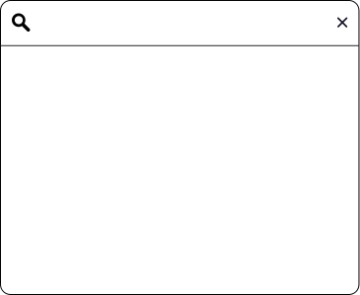
Introduction
The Challenge: In today's digital world, users often struggle to choose what movie to watch because of the huge number of available options. Most existing recommendation systems suggest popular or previously watched movies, which can become repetitive and less engaging.
The Opportunity: Traditional systems ignore a key piece of context: the user's current emotional state. Incorporating mood can lead to more satisfying and personalized suggestions.
Our Solution: This report details a hybrid recommendation system. It first predicts user ratings for movies using a Singular Value Decomposition (SVD) model trained on a user-item rating matrix. Subsequently, it filters these predictions based on the user's selected mood to provide contextually relevant suggestions.

Slide 3
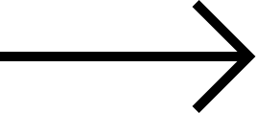
Objectives
To identify the user’s mood by asking simple questions or letting them select from mood options, so recommendations match how they feel.
To use SVD (Singular Value Decomposition) to find hidden patterns in user ratings and movie preferences for better predictions.
To combine mood information with mathematical models to give more accurate and personalized movie suggestions.
To measure the system’s performance using metrics like RMSE, precision, and recall to ensure good recommendation quality.

Slide 4

Methodology
1
User Input
User logs in and enters their current mood.
Optionally adds favorite actor or preferred genre for personalized results.
2
Data Processing
System analyzes mood and preferences
Checks the movie database for matching tags (mood, genre, actor, etc.)
3
Movie Recommendation
Recommends movies that best match the user’s mood and preferences
4
User Feedback
User can like or dislike the recommendation and
feedback is stored and used to improve future recommendations

Slide 5
Application of SVD
Singular Value Decomposition (SVD) is a powerful mathematical technique, fundamental to many recommendation systems. It's a type of matrix factorization used in collaborative filtering.
At its core, SVD takes a large, often sparse, user-item rating matrix and decomposes it into several smaller matrices. These matrices represent latent factors—hidden characteristics of both users (e.g., their taste dimensions) and items (e.g., movie attributes).
By understanding these latent factors, SVD can efficiently predict missing ratings, allowing the system to recommend unseen movies that a user is likely to enjoy.
SVD's Role and Analogy:
Core Idea: SVD looks through the surface-level ratings to uncover the "latent factors"—the hidden reasons or characteristics behind the choices, such as "dark visuals" or "romantic plot".
Analogy: Think of SVD as an X-ray machine; it looks through the ratings to see the underlying connections.
Application: SVD is particularly useful because it is excellent at handling sparse data (a matrix with many empty or missing values), allowing it to fill in the blanks and predict unknown scores.

Slide 6
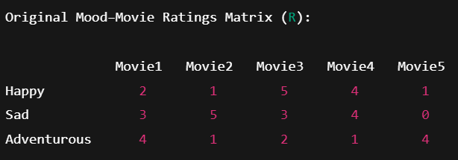
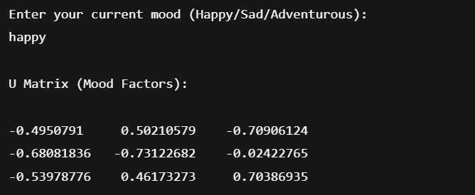
Building the Mood-Rating Matrix
The Ratings Matrix R is built in such a way that each row represents a mood and each column represents a movie
Using Singular Value Decomposition (SVD), we can break this into three new matrices U, Sigma, and V Transpose.
U (Mood Feature Matrix):
Rows → Moods
Columns → Genres or hidden features or latent factors
This shows how strongly each mood is connected to different latent factors.

Slide 7
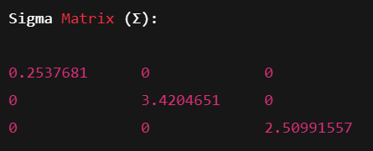
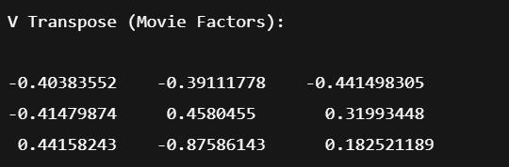
Building the Mood-Rating Matrix
Σ (Sigma Matrix):
A diagonal matrix where each diagonal element represents the importance or strength of a hidden feature.
A larger value means it has a greater impact on the recommendation.
Vᵀ (Movie Feature Matrix):
Rows → Genres or hidden features
Columns → Movies
Shows how much each movie fits into a specific latent factor.
Now the missing spots in R formed by multiplying back U, Σ, Vᵀ are filled by calculating the mean/average of missing spot’s row.
Here R shows how each movie is related to a mood, and when user inputs the mood, movies linked to the moods are recommended.

Slide 8
Data Collection and Preprocessing
Data Collection:
Collect all customer ratings and structure the data in a giant grid. Users on one side, Ratings on the other, and Movies in the middle. This is the foundation of our entire system.
Sparsity:
Over 95% of the data is empty because most of the users only rate a few movies. This massive amount of blank data is our main challenge
Missing Value Imputation:
Use smart statistical averages (like a user's average rating) to Intelligently guess the missing scores.
Normalization of ratings:
Adjust ratings to account for users who generally rate everything high or low, ensuring fairness using algorithm.
Final Output:
Deliver a complete, clean, and balanced dataset ready for the SVD(Singular Value Decomposition) algorithm to find hidden patterns.

Slide 9
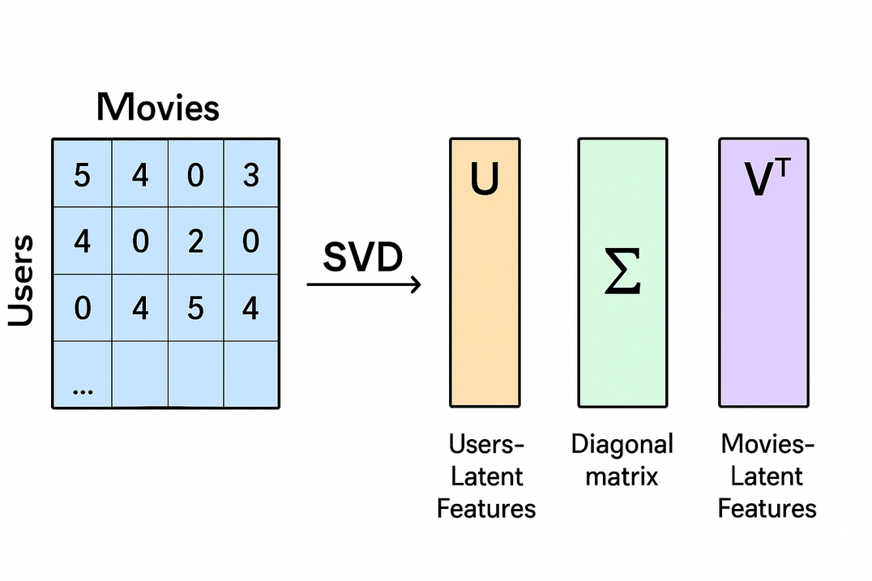
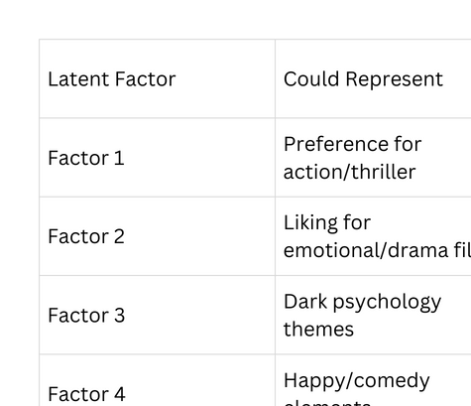
SVD: Decomposing to Latent Factors
Why Latent Factor Decomposition?
In real-world rating datasets, most users have rated only a small subset of movies, resulting in a sparse matrix.
SVD reduces this high-dimensional sparse matrix into smaller dense matrices that capture hidden preference patterns.
This allows the system to estimate missing ratings and make predictions for movies the user hasn’t watched yet.
R = U Σ Vᵀ

Slide 10
Making the Recommendation: Prediction Power
How the Prediction Works
Once the original user–movie rating matrix is decomposed using SVD into U, Σ, and Vᵀ, each of these matrices captures different hidden patterns:
U stores mood of the user
Vᵀ stores the movie and features of it.
Σ gives importance weights to those features
What actually happens during prediction
Identify user preferences
From U, the system understands if a user wants comedy, action, or romance.
Identify movie characteristics
From Vᵀ, it learns which movies are action-heavy, emotional, dark, humorous, etc.
Multiply U, Σ, Vᵀ
Combining them tells how strongly a user’s taste matches each movie’s features
Generate a predicted rating score
Example: User has not watched Movie X
After reconstruction, Movie X might have a predicted score like 4.6/5
Higher score → more likely the user will enjoy it
Sort predicted ratings & recommend top movies that the user hasn't rated before

Slide 11
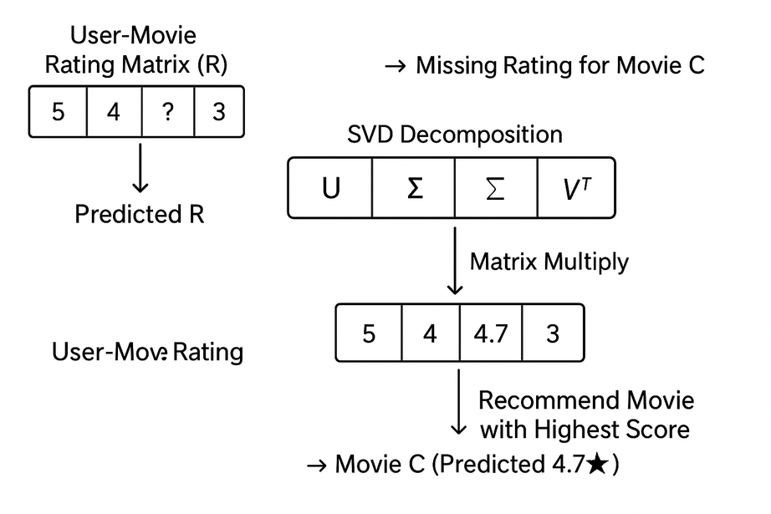
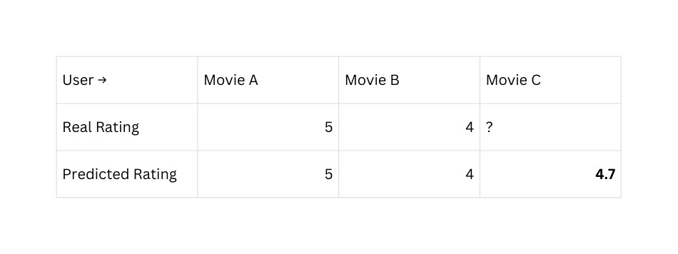
Making the Recommendation: Prediction Power
Why this is Powerful?
User doesn’t need to rate many movies
System learns from similar users and patterns
Can recommend movies no one explicitly asked for
➡ Prediction is based on matching user taste with movie features
mathematically.
User never watched Movie C, but model predicts they'll rate it ~4.7,
so it becomes a recommended movie.
In short:
The model learns patterns → estimates missing ratings → recommends the highest ones.

Slide 12
Evaluating Recommender System Performance
RMSE (Root Mean Square Error)
Measures the difference between predicted and actual ratings.
Lower RMSE → higher accuracy.
Precision
Shows how many recommended movies are actually liked by the user.
Focuses on quality of recommendations.
Recall
Shows how many of the user's liked movies are successfully recommended.
Focuses on coverage of good recommendations.
F1-Score
Balances Precision and Recall
High F1 → both accurate and complete recommendations.

Slide 13
Tools and Technologies Used
Programming Language
Python – Core language for implementing algorithms, data processing, and backend logic.
Libraries and Frameworks
NumPy, Pandas, SciPy – For data analysis, manipulation, and performing SVD on sparse matrices.

Slide 14
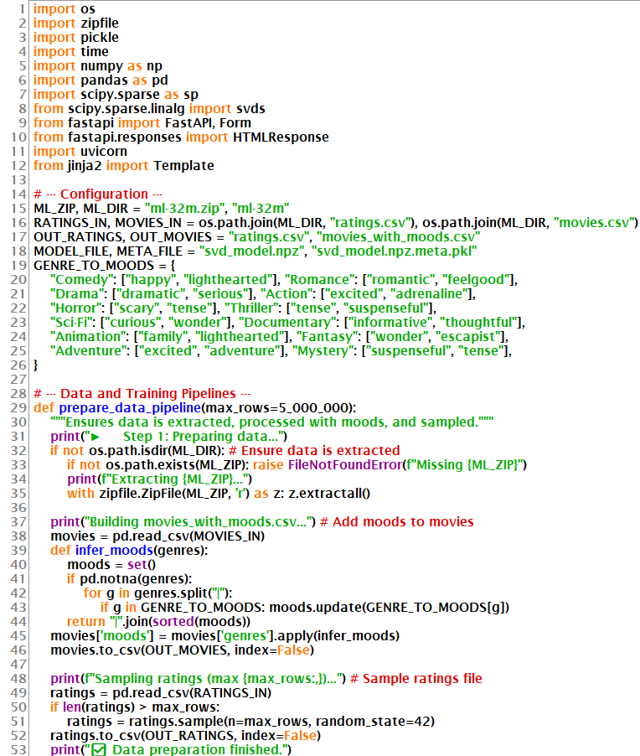
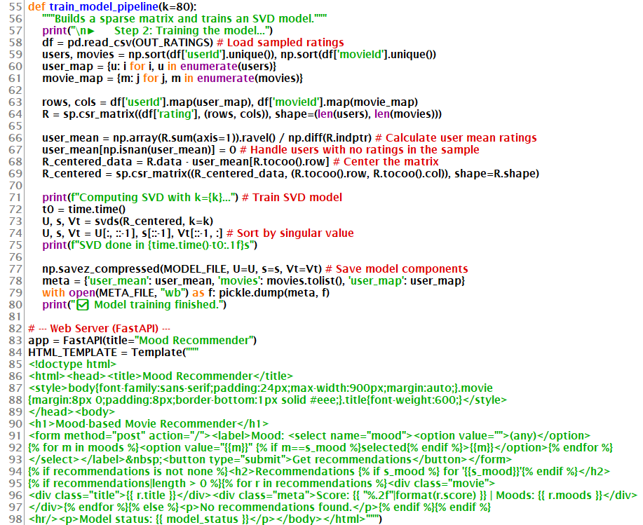
Code

Slide 15
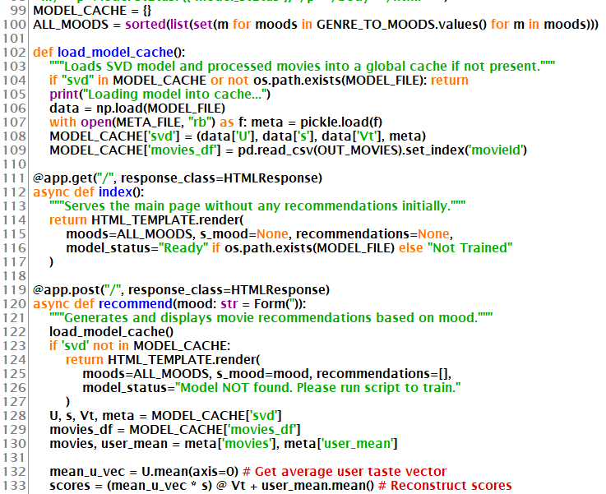
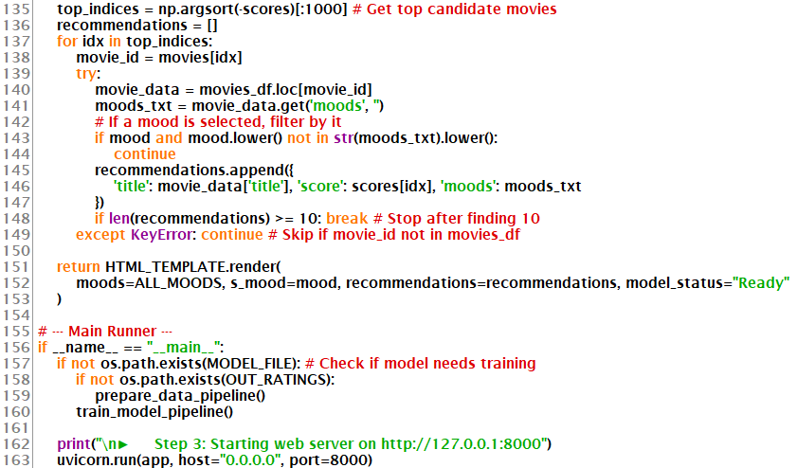
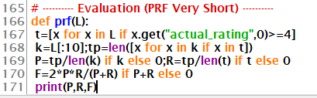

Output

Slide 16
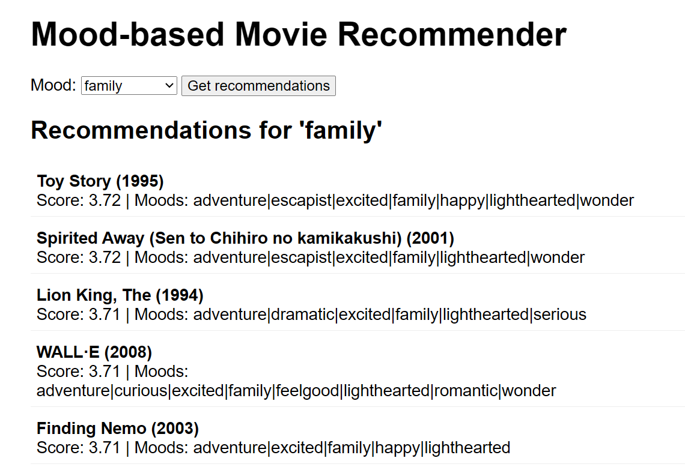
Website

Slide 17
References
MovieLens Dataset: https://grouplens.org/datasets/movielens/
FastAPI Framework: https://fastapi.tiangolo.com/
Ngrok for Deployment: https://ngrok.com/docs
Python Libraries: https://numpy.org/, https://pandas.pydata.org/, https://scipy.org/
Dataset Source (Kaggle): https://www.kaggle.com/datasets
Project Demo Link: https://joana-blepharitic-nancey.ngrok-free.dev

Slide 18


Thank You

